Slide 1
Wetland Creation
Why and How
Char Ison and Caleb Asbury

Slide 2
What is a Wetland
A wetland contains land that is wet, although it may not be wet year round. Water must be in large enough quantities (either at the surface or in groundwater) during the growing season. Most wetlands are associated with shallow water and aquatic plants. Wetlands are often characterized as a transition from upland to aquatic habitat.

Slide 3
Types of Wetlands
Types:
Bog, swamp, fen, prairie pothole, marshes (tidal and non-tidal), wet meadow, vernal pool, etc.
Categories:
Emergent and forested
Wetland types differ primarily by where their water comes from (groundwater, surface water, and precipitation) as well as other factors (landscape position, latitude, pH, salinity, soils, inundation frequency, etc.)

Slide 4
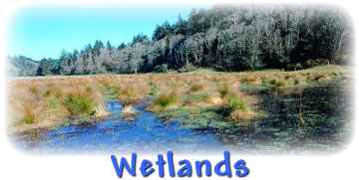
Wetland Importance
Water purification
Water storage
Prevent saline intrusion
Groundwater recharge and discharge
Flow regulation and flood mitigation
Critical habitats for plants and animals
Biodiversity

Slide 5
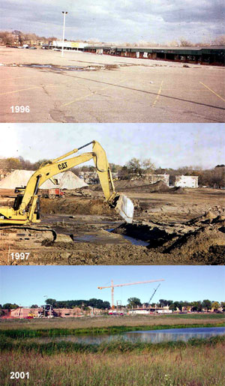
Reasons to Make a Wetland
Stormwater treatment
Landscaping (rain garden)
Treatment of heavy metals, sewage, etc.
Sediment and nutrient uptake and capture
Mitigate (offset for) damages to wetlands made during construction or development

Slide 6
How to Create a Wetland
Caleb Asbury, Davey Resource Group

Slide 7
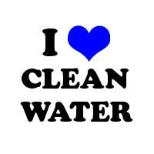
Wetland Permitting
Permitting is required if:
Impacting a wetland by dredging or filling
Required through the Clean Water Act
The US EPA oversees the CWA
The US Army Corps of Engineers provides enforcement for “waters of the US”
IDEM regulates “water of the state”

Slide 8
Wetland Permitting
Permitting is required if:
Indiana Division of Natural Resources
Lowering of 10 Acre Lakes
Lake Preservation Act
Navigable Waterways Act
Flood Control Act
Local zoning and ordinances may require permitting
County Surveyors must be aware if the wetland will affect a regulated drain

Slide 9
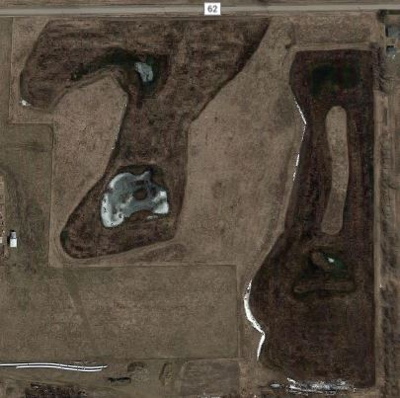
Wetland Creation Example
Real world example in Laotto, IN
Wetland creation from scratch
Hydrology comes from precipitation
Hydrology controlled by water control box

Slide 10
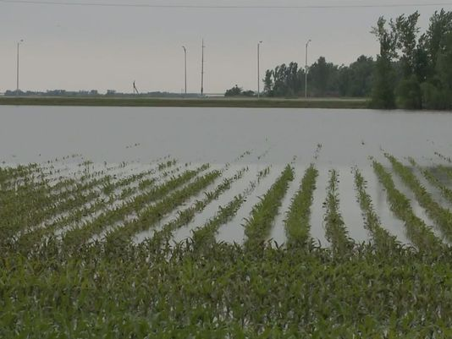
First, Find a Site
A suitable site must be found for wetland creation
Looking for water inputs
Existing wetland vegetation
Soils with hydric properties
Also will need permission from landowner

Slide 11
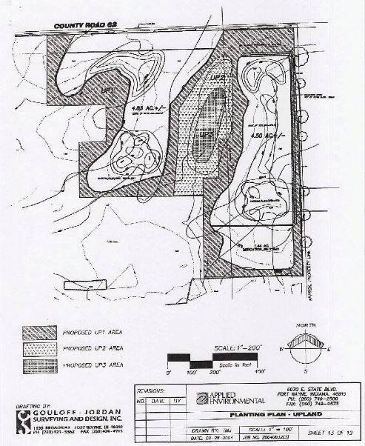
Design
Professional Survey
Engineers
Must design a wetland that provides adequate hydrology, soils, and vegetation
These are the three large components required for mitigation projects to succeed.

Slide 12
Coordination
Keep all stakeholders involved
Landowner
Regulatory agencies
County Surveyor
Client (entity causing mitigation process)
Engineers/surveyors
Earthwork contractor
Submit mitigation plan to regulatory agencies for approval--it contains goals required for eventual mitigation release

Slide 13
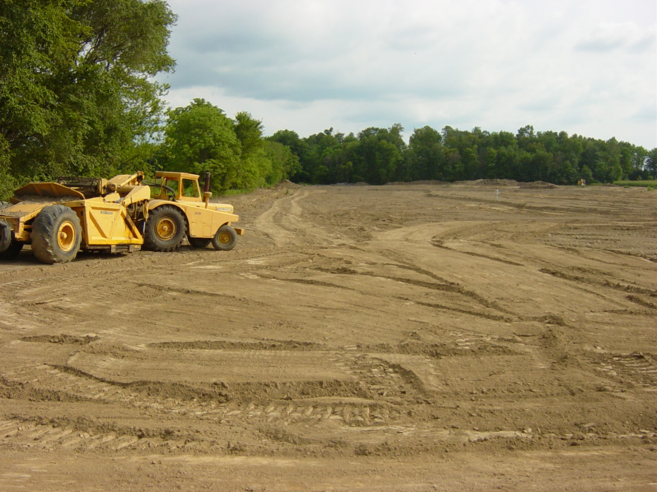
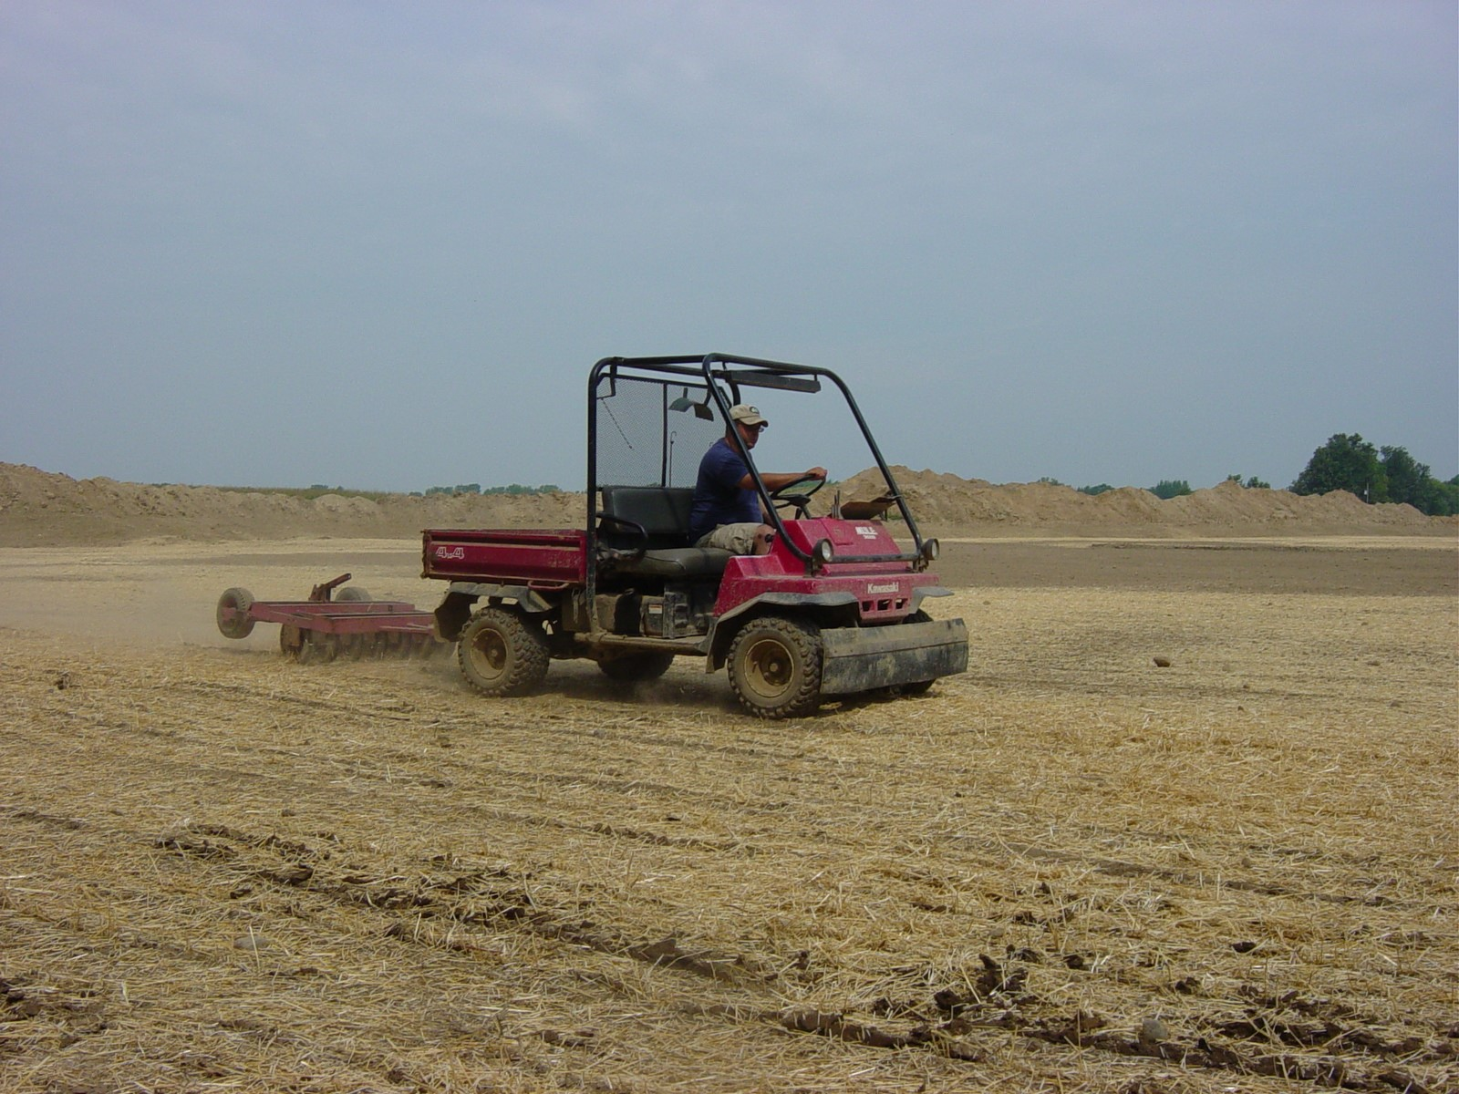
Construction
Can we build it? Yes we can! They said it was OK!
Microtopography is a good thing
Lots of planting

Slide 14
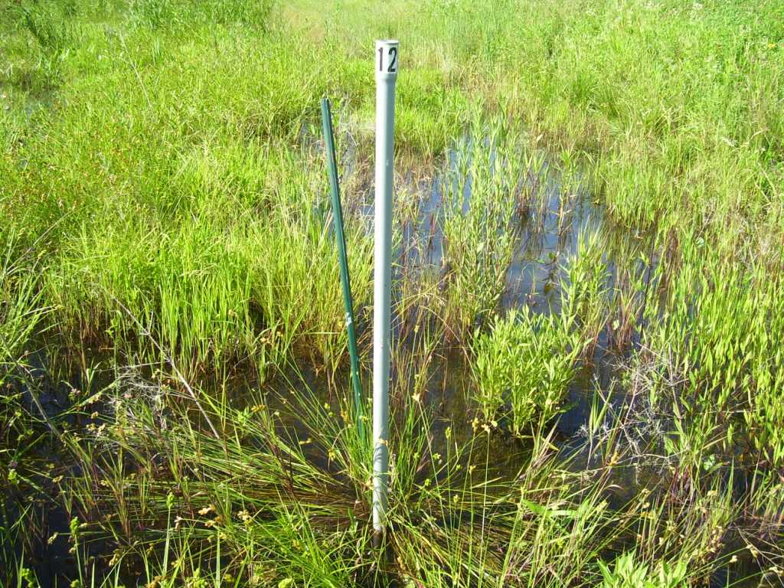
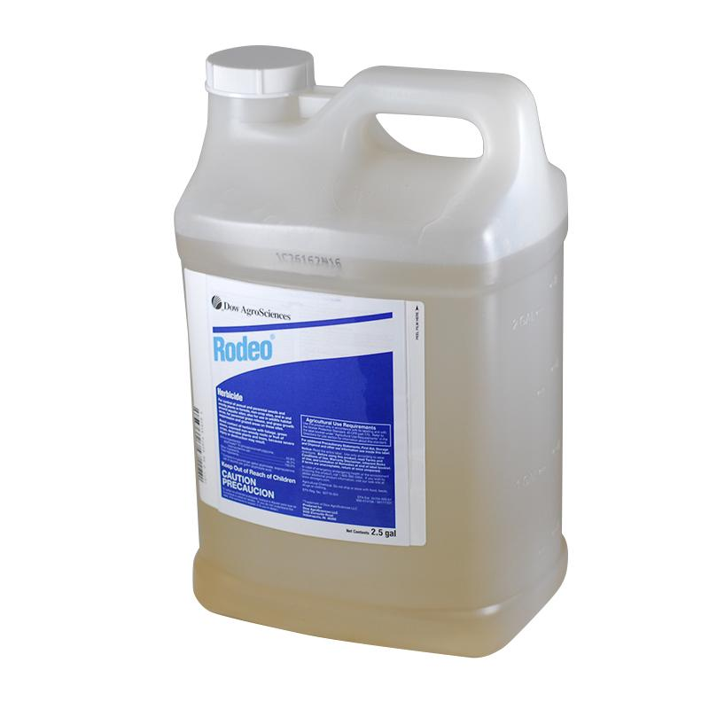
Maintenance
Make sure the goals of the mitigation plan are being met
Keep invasive species out
Additional seeding and planting may be required--keep in touch with agencies

Slide 15
Apply for Release
Generally:
IDEM regulated mitigation sites (isolated wetlands) and USACE-IDEM (“waters of the US”) must meet goals for 3 consecutive years
Mitigation typically lasts 5 years or 10 years.
The mitigation process is extended if goals are not met in this timeframe

Slide 16
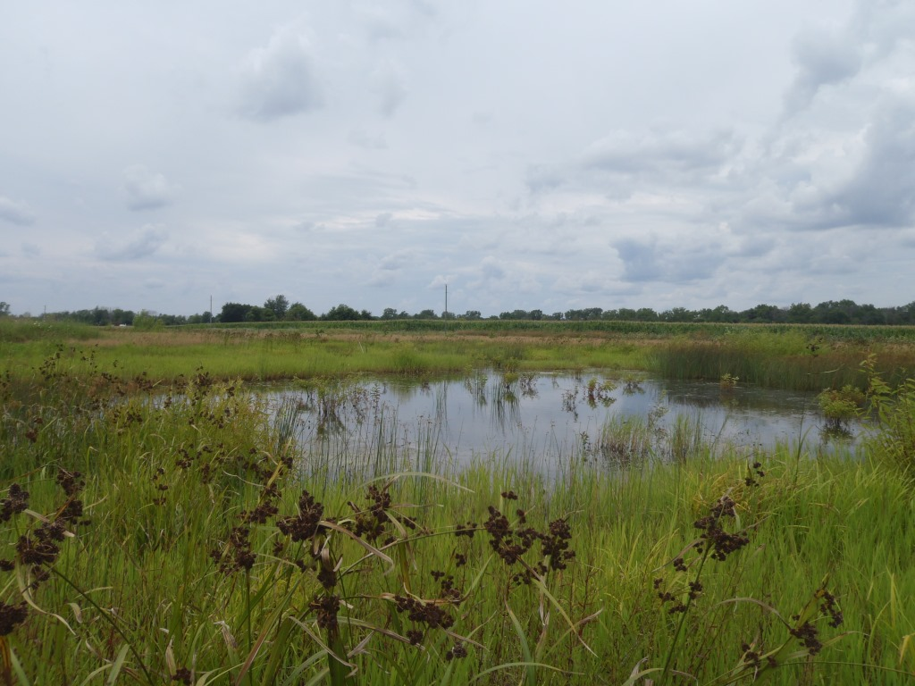
Hopefully Ending with...

Slide 17
Questions?
Thank you all for listening and we hope you learned something!

